Slide 1
Cognitive Self-Service Agent for Banking

Slide 2
Requirements
Replace live agents for common services
Cognitive agents should be conversational
Provide ability to integrate with existing contact centers
Balance enquiry and statement generation
To integrate it with voice Gateway to answer in human like manner.
To make it cognitive to make it evolve over time

Slide 3
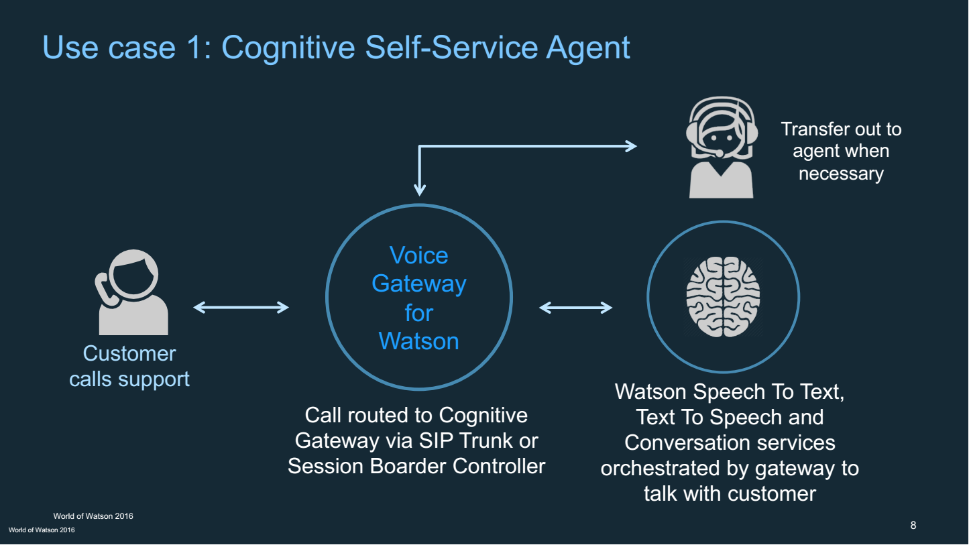

Slide 4
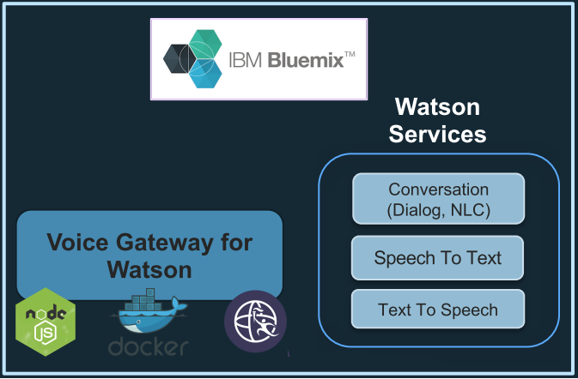



Self Service Agents
Ask Watson about…
CASA: account balance, statements, etc.
SIP
SOAP

Slide 5
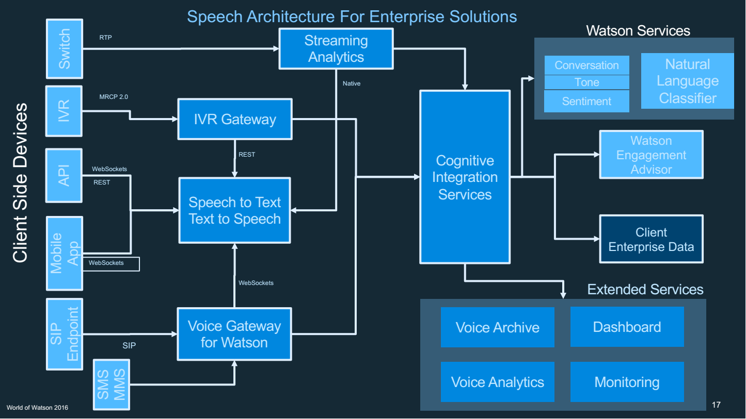

Slide 6
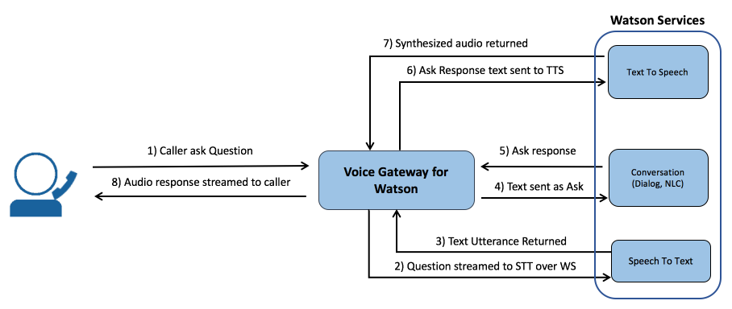
Bank
Web Service Endpoint
request
response

